Slide 1
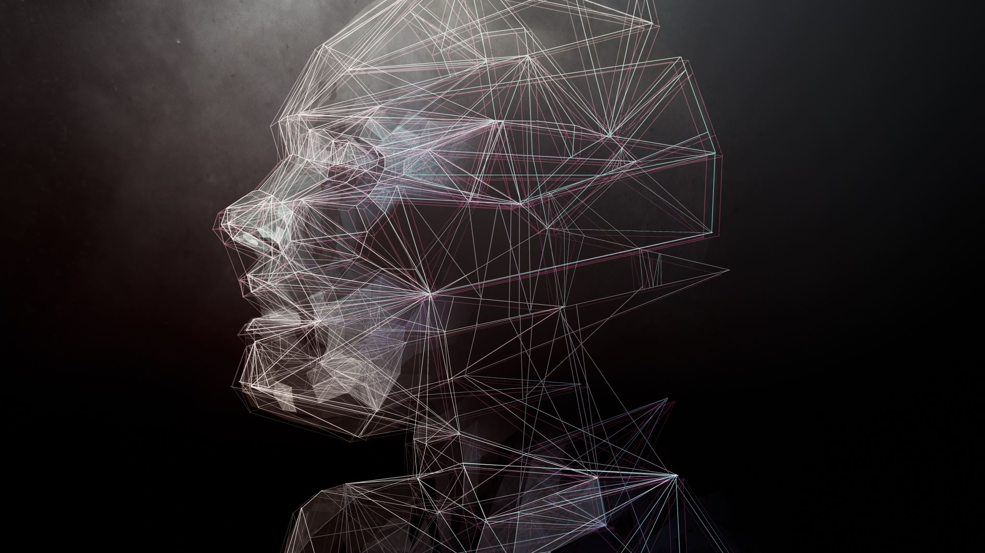
Human Image Segmentation
Team Members:
Vishnu Vardhan Koganti
Shiva Kumar Lakkampally
Sreeja Garlapati

Slide 2
Project Topic:
Develop a robust human picture segmentation algorithm using color-based segmentation, edge detection, and deep learning techniques. The project aims to enhance the accuracy and reliability of segmenting human images under diverse lighting conditions and backgrounds, with potential applications in human-computer interaction, video surveillance, and medical imaging.

Slide 3
Statement of Project Objectives
Develop a human image segmentation model based on the techniques outlined in the paper "Human Image Segmentation."
Create a diverse dataset of human photographs with various lighting conditions, backdrops, and positions for training and evaluation.
Implement and train convolutional neural networks (CNNs) using PyTorch to achieve state-of-the-art results in human image segmentation.
Compare the performance of the proposed model with other segmentation strategies.

Slide 4
Statement of Value
Human image segmentation has applications in various fields like computer vision, object recognition, activity recognition, medical imaging, and surveillance systems.
The project aims to improve the precision and robustness of human image segmentation, addressing a significant challenge in the field.
It will provide a valuable tool for researchers and practitioners working on image analysis and computer vision tasks.
Addressing the challenges of reliably segmenting human pictures under different conditions.

Slide 5
Review of the State of the Art and Relevant Works
The paper "Human Image Segmentation" by S. R. Kharabe et al. serves as a foundation for the project.
Citations:
Qiu, T., Wang, X., & Wang, H. (2018). Human segmentation from natural images via deep multitask representation learning. Journal of Visual Communication and Image Representation, https://www.sciencedirect.com/science/article/abs/pii/S104732031830097X?via%3Dihub
Chen, L., Papandreou, G., Kokkinos, I., Murphy, K., & Yuille, A. L. (2018). Deeplab: Semantic image segmentation with deep convolutional nets, atrous convolution, and fully connected CRFs. IEEE Transactions on Pattern Analysis and Machine Intelligence, 40(4), https://ieeexplore.ieee.org/document/7913730
Hu, J., Shen, L., & Sun, G. (2018). Squeeze-and-excitation networks. In Proceedings of the IEEE Conference on Computer Vision and Pattern Recognition https://ieeexplore.ieee.org/document/8578843

Slide 6
Review of the State of the Art and Relevant Works – Cont..
Additional relevant works include:
"Human segmentation from natural images via deep multitask representation learning" by T. Qiu et al.
"Deeplab: Semantic image segmentation with deep convolutional nets, atrous convolution, and fully connected CRFs" by L. Chen et al.
"Squeeze-and-excitation networks" by J. Hu et al.

Slide 7
Approach
Data Collection: Gather diverse human photos with diverse lighting conditions, backdrops, and positions from internet image archives, people around the University, and personal images. Apply augmentations like scaling, rotation, flipping , inversion, and noise addition to enrich and diversify the dataset.
Preprocessing: Convert RGB photos to YCbCr color space. Apply global thresholding using the Otsu method for luminance. Apply local thresholding using the Sauvola method for chrominance. Combine the resulting binary masks to create the final segmentation mask.
Deep Learning Models: Utilize PyTorch to build CNNs. Train models using stochastic gradient descent (SGD) and Adam optimization.
Evaluation: Assess the performance using metrics like accuracy, recall, and F1-score. Compare results with the methodology presented in the paper.

Slide 8
Deliverables
The project will contribute to the field of computer vision and offer a reliable approach for various applications, including object recognition, activity recognition, and surveillance systems
Developed human picture segmentation algorithm incorporating color-based segmentation, edge detection, and deep learning techniques.
Diverse dataset of human photos with varying lighting situations, backdrops, and positions.
Trained PyTorch models for human picture segmentation.
Comparative analysis report detailing the performance of the developed algorithm against existing methods.
Code for data loading, model initialization, and model training.

Slide 9
Evaluation Methodology
Metrics: Accuracy, Recall, F1-score.
Evaluation Process: Compare the segmentation results of the developed algorithm with ground truth masks. Calculate metrics using a separate collection of human photos.
Criteria for Success: Achieving higher Metrics compared to the baseline method. Handling diverse lighting conditions, backgrounds, and positions effectively.

Slide 10
THANK YOU!!!

